Slide 1

SAPUI5 Training

Slide 2
What is Controls in SAPUI5?
In SAPUI5, a control is a user interface element that is used to display information, receive input from the user, or both. Controls can be thought of as building blocks for creating the user interface of an application. Examples of controls in SAPUI5 include labels, buttons, Inputs, dropdown, text area, checkboxes and tables etc.
Some of the controls are :
Input:
Allows the user to enter and edit text or numeric values in one line.
Overview
You can enable the autocomplete suggestion feature and the value help option to easily enter a valid value.
Guidelines
Always provide a meaningful label for any input field.
Limit the length of the input field. This will visually emphasize the constraints for the field.
Do not use the Placeholder property as a label.
Use the description property only for small fields with no placeholders(i.e. for currencies).
Properties
editable/read-only
enabled/disabled
Placeholder
text direction
Value states

Slide 3
Events
liveChange - Fired when the value of the input is changed by user interaction - each keystroke, delete, paste, etc.
Submit - This event is fired when user presses the Enter key on the Input.
valueHelpRequest - When the value help indicator is clicked, this event will be fired.
Usage
When to use : Use the control for short inputs like emails, phones, passwords, fields for assisted value selection.
When not to use: Don't use the control for long texts, dates, designated search fields, fields for multiple selection.
Syntax :
<Input id=“idVH“ class="sapUiSmallMarginBottom"type="Text“ placeholder="Enter product“ showValueHelp="true“ valueHelpRequest="handleValueHelp"/>
Select:
The sap.m.select control provides a list of items to select an item.
Properties
selectedKey
name
required
editable
enabled

Slide 4
Events
Change - The event is fired when the value in the selection field is changed.
liveChange - Fires when the user navigates through the select items. It’s also fired on a revert currently selected item
ComboBox :
A drop-down list for selecting and filtering values.
Overview
The control represents a drop-down menu with a list of the available options and a text input field to narrow down the options.
Usage :
When to use:
You need to select only one item in a long list of options (between 13 and 200) or your custom user input.
When not to use:
You need to select between only two options. Use a switch control instead.
You need to select between up to 12 options. Use a select control instead.
You need to select between more than 200 options. Use a input control with value help instead.
Properties
selectedKey
filterSecondaryValues

Slide 5
Events
Change - The event is fired when the value in the text input field is changed
selectionChange - This event is fired when the user types something that matches with an item in the list; it is also fired when the user presses on a list item, or when navigating via keyboard.
Buttons :
Enables users to trigger actions
Overview
The user triggers an action by clicking or tapping the button or by pressing certain keyboard keys such as Enter.
Usage
For the Button UI, you can define text, icon, or both. You can also specify whether the text or the icon is displayed first.
You can choose from a set of predefined ButtonTypes that offer different styling to correspond to the triggered action.
Properties
icon
iconFirst
text
type

Slide 6
Events
press - Fired when the user clicks or taps on the control.
VizFrame :
VizFrame is a viz control that manages a visualization’s initialization, layout, feeding, customization and interactions.
Properties
vizProperties
vizScales
vizType
Aggregations
dataset
feed
Events
deselectData - Event is fired when certain data points are deselected, data context of deselected items would be passed
renderComplete - Event fires when the rendering ending
selectData - Event fires when certain data point(s) is(are) selected, data context of selected item(s) would be passed in.

Slide 7
Dialogs and Fragments
Dialogs :
A popup that interrupts the current processing and prompts the user for an action or an input in a modal mode.
Overview
The Dialog control is used to prompt the user for an action or a confirmation. It interrupts the current app processing as it is the only focused UI element and the main screen is dimmed/blocked. The content of the Dialog is fully customizable.
There are other specialized types of dialogs:
Personalization Dialog - used for personalizing sorting, filtering and grouping in tables
Select Dialog - used to select one or more items from a comprehensive list
Table Select Dialog - used to make a selection from a comprehensive table containing multiple attributes or values
Value Help Dialog - used to help the user find and select single and multiple values
View Settings Dialog - used to sort, filter, or group data within a (master) list or a table
Busy Dialog - used to block the screen and inform the user about an ongoing operation
Usage
When to use:
You want to display a system message.
You want to interrupt the user’s action.
You want to show a message with a short and a long description.

Slide 8
When not to use:
You just want to confirm a successful action.
Properties
Stretch
showHeader
Resizable
Draggable
horizontalScrolling
Title
verticalScrolling
Type
Events
afterClose - This event will be fired after the Dialog is closed.
afterOpen - This event will be fired after the Dialog is opened.
beforeClose - This event will be fired before the Dialog is closed.
beforeOpen - This event will be fired before the Dialog is opened.

Slide 9
Fragments :
Fragments support the definition of light-weight stand-alone UI control trees. Fragments are used similar as sap.ui.core.mvc.Views, but Fragments do not have a Controller on their own.
Difference between Dialogs and Fragments
Dialogs | Fragments
Dialogs are standalone UI components that are typically used to display information or prompt the user for input. They are created and opened programmatically using JavaScript code. | Fragments, on the other hand, are reusable pieces of UI code that can be included in other UI components, such as Views or Dialogs.
Dialogs have their own controller, which is separate from the controller of the View or the component that created them. Dialogs are typically used for short, one-time interactions with the user | Fragments, on the other hand, share the controller of the UI component they are included in. Fragments are used for more complex UI components that may be reused in multiple places throughout an application.
Dialogs have their own lifecycle methods, such as "onBeforeOpen" and "onAfterClose", which are called when the dialog is opened or closed. | Fragments do not have their own lifecycle methods, but instead rely on the lifecycle methods of the UI component they are included in.

Slide 10
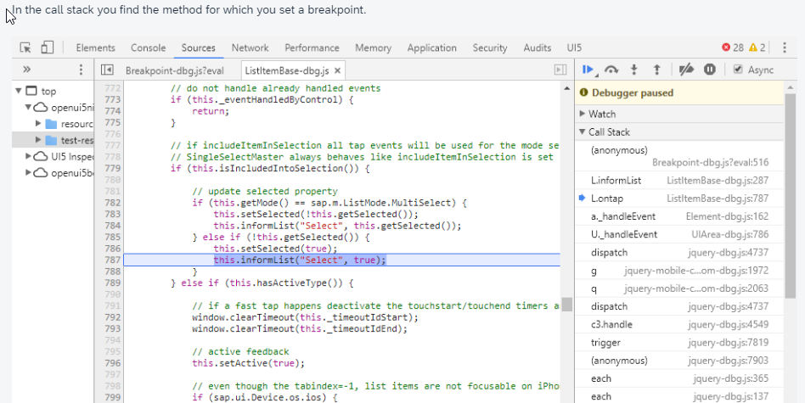
Debugging in SAPUI5
When developing apps, searching for bugs is an inevitable part of the process. To analyze an issue, you can use the developer tools of your browser and built-in SAPUI5 tools. In this section, we give an overview of the SAPUI5 tools you can use when debugging. To learn more about the developer tools of your browser, check the documentation of the browser.
Breakpoints on the Object Level
Open the Control Tree view of the Diagnostics window.
Select a control in the tree.
You can also press and hold Ctrl +Shift +Alt and select a control in your app to select it in the tree.
Select the Breakpoints tab on the right.
From the dropdown list, select the method for which you want to set the breakpoint and choose Add breakpoint.
The selected methods are listed below the dropdown list.
Open the developer tools of your browser. Whenever the selected methods are called for any instance on the control, the code execution is paused in the debugger.

Slide 11



